Slide 1
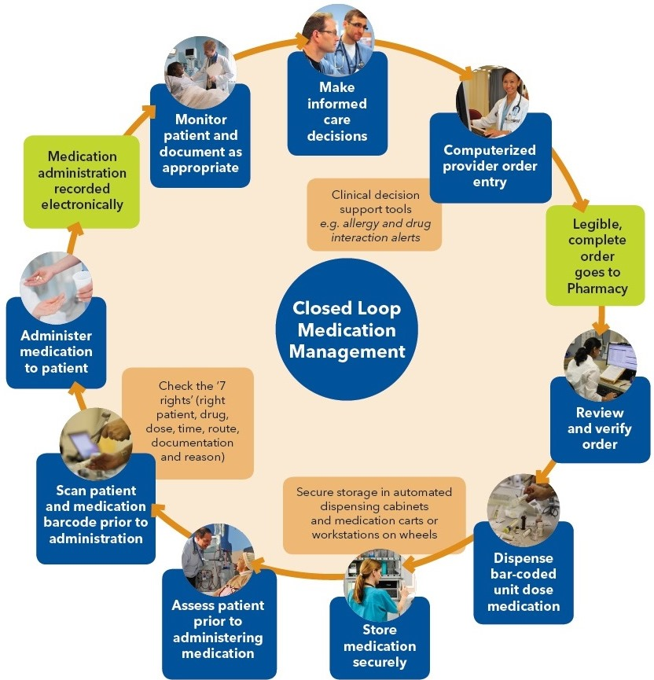
Closed Loop Medication Management System
Notes:
Closed loop medication management is a fully electronic medication management process, in which all relevant information is documented seamlessly.
All the steps of the medication cycle are supported electronically – ordering, verifying, preparing and administering – with decision support where relevant. It’s all about safety.
Closed loop medication management requires four things: an active medication order; an electronically-identified provider (nurse); a bar-coded drug; and an electronically-identified patient.
Care providers will enter orders directly into the computer, so they’re transmitted directly to the pharmacy for verification and dispensing. The pharmacy will break down medications into single pre-measured doses, which are bar-coded. Most patients will also have bar-codes on their armbands. Each medication order will be linked to the patient’s bar-code and the medication bar-code. This is to make sure that the right patient gets the right dose of the right medication, at the right time and by the right route (oral, IV, etc.). Scanning the bar-codes will result in the right documentation being entered into the clinical information system.
How else does it help patients?
No more legibility issues
Reduced turnaround.
At the moment, the medication order sits in a chart until it is faxed, and can sit on fax machines or desks until it’s picked up and processed. Closed loop medication management means clinicians will be able to receive and review orders online.

